Slide 1


International Conference on Science, Mathematics, Environment,and Education (ICoSMEE)
Modeling Stock Prices Using Mixture Autoregressive Model
by
Dwilaksana Abdullah Rasyid
Irhamah
Pratnya Paramitha Oktaviana
Nur Iriawan

Slide 2
INTRODUCTION

Slide 3

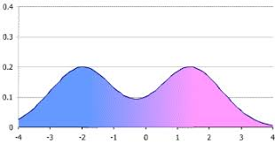
INTRODUCTION
Notes:
Forecasting is an activity that aims to estimate events that will occur in the future, based on serial events in the past.
forecasting method is mostly developed based on residual assumptions with uni-modal Normal distribution and must be liniear or we can called it (ARIMA)
If we have non liniear series we can use mixture model, in this case we can use Mixture Autoregressive (MAR)

Slide 4
LITERATURE REVIEW

Slide 5
Mixture Distribution
Notes:
Where F is the function of mixture distribution
And pi is the weight of each distribution

Slide 6
Mixture Autoregressive
If residual normally distibuted
If residual have Student T distibution
Notes:
This is the formula for Mixture Autoregressive
And the estimation of parameter we can use Expectation Maximisation

Slide 7
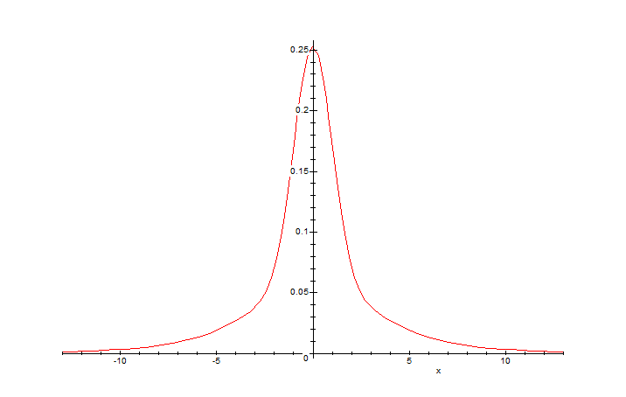
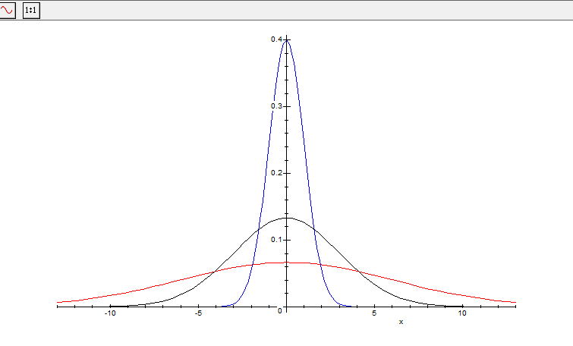
Mixture Autoregressive
if the series is at difference
but it must be in mixture distribution
Notes:
In this case we have to use Augmented Diggie Fuller test to make sure if this series is stationary
But diggie fuller test not testing if the series have two or more distribution
In that case we should have use MATEMATICA software to make sure

Slide 8
METHODOLOGY

Slide 9



Data Sources and Research Variables
PT. Telekomunikasi Indonesia (TLKM)
PT. Indonesian Satellite (ISAT)
PT. Excelkomindo (EXCL)
Starts from the date of IPO in each company
End in 30 April 2018

Slide 10
ANALYSIS AND DISCUSSION

Slide 11
DESCRIPTION
EXCL
ISAT
TLKM
Stock Code | N | Mean | StDev | Min | Max
EXCL | 3066 | 3557.9 | 1532.9 | 799 | 7102
ISAT | 3457 | 5371.5 | 1040.6 | 3200 | 9900
TLKM | 3319 | 2174.3 | 985.8 | 825 | 4800
Notes:
From this plot we can take conclusion by visual that three of them is not a linear series

Slide 12
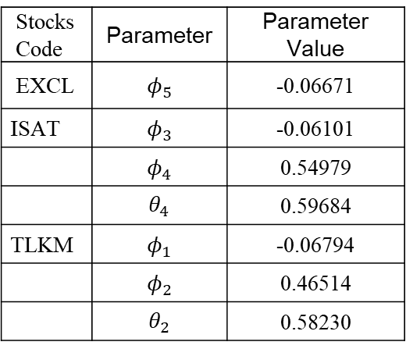
Modelling with Autoregressive Integrated Moving Average (ARIMA)
The residual assumption with normal
distribution from all ARIMA model is not fulfilled
It because the series is not liniear
Stocks Code | Parameter | Parameter Value
EXCL | $$φ_{5}$$ | -0.06671
ISAT | $$φ_{3}$$ | -0.06101
 | $$φ_{4}$$ | 0.54979
 | $$θ_{4}$$ | 0.59684
TLKM | $$φ_{1}$$ | -0.06794
 | $$φ_{2}$$ | 0.46514
 | $$θ_{2}$$ | 0.58230
Terasvirta Linearity Test
Stocks Code | P-Value
EXCL | 2.645x10⁻⁵
ISAT | 0.01965
TLKM | 0.005252

Slide 13
Modelling with Mixture Autoregressive (MAR)
 | TLKM |  | ISAT |  | EXCL
Parameter | StMAR(2;3,3) |  | StMAR(2;3,3) |  | StMAR(2;1,1)
 | Value | Standard error | Value | Standard error | Value | Standard error
Component 1
α₁ | 0.8625 |  | 0.9714 |  | 0.9196
φ_{0,1} | 1.2437 | 0.7526 | 0.0123 | 1.9683 | 0.0638 | 0.0007
φ_{1,1} | -0.0245 | 0.0221 | 0.0306 | 0.0209 | 0.9919 | 0.0001
φ_{2,1} | -0.1091 | 0.0218 | -0.0353 | 0.0207
φ_{3,1} | -0.0752 | 0.0219 | -0.0255 | 0.0211
σ₁ | 2088.244 | 182.0159 | 18000 | 187.9051 | 0.0022 | 0.000077
ν₁ | 0.854 | 0.0428 | 0.915 | 0.0348 | 0.8291 | 0.027
Component 2
α₂ | 0.1374 |  | 0.0285 |  | 0.0803
φ_{0,2} | 1.0392 | 1.1092 | -4.99 | 2.4424 | 5.3E-07 | 0.000047
φ_{1,2} | -0.2304 | 0.0731 | -0.162 | 0.1148 | 0.9999 | 0.000036
φ_{2,2} | -0.1683 | 0.0947 | 0.0099 | 0.1238
φ_{3,2} | -0.0971 | 0.1005 | -0.308 | 0.149
σ₂ | 244.7687 | 40.335 | 40700 | 0.122 | 4E-08 | 0.000036
ν₂ | 4.7197 | 0.6759 | 4.11 | 0.3229 | 2.6298 | 0.05718

Slide 14
Comparison of ARIMA and MAR Model
Methods | Goodness Model | EXCL | ISAT | TLKM
ARIMA | MSE | 523623.9 | 5089860 | 144329.6
 | AIC | 36812.06 | 43447.35 | 34030.93
 | BIC | 34029.26 | 43445.36 | 33894.06
MAR | MSE | 1369.271 | 54.02107 | 54.75952
 | AIC | -8442.88 | 41762.80 | 33070.21
 | BIC | -8394.03 | 41842.55 | 33149.51
Notes:
from this table we can see the comparison from each method
We can see MSE, AIC and BIC value from MAR model is smaller than ARIMA model
We can conclude the MAR model better than ARIMA

Slide 15
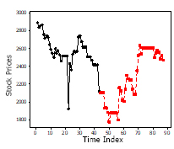
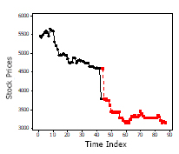
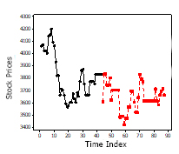
MAR Forecasting Result
based on the StMAR method on PT. Excelcomindo Pratama Tbk. recommended buying shares at the beginning of May 2018, at PT. Indonesian Satellite Corporation Tbk. recommended selling shares at the beginning of May 2018 and for PT. Telekomunikasi Indonesia Tbk is selling or storing shares to get higher profit.

Slide 16
CONCLUSION

Slide 17
Conclusion
buy or sell shares in the opening section of the share price in the period 1 May 2018 to 5 May 2018
based on the StMAR method at PT. Excelcomindo Pratama Tbk. and PT. Indonesian Satellite Corporation Tbk. is selling existing shares.
the decision for PT. Telekomunikasi Indonesia Tbk. is to buy shares or store existing shares for higher profits

Slide 18
Reference
Wong, C. S. and Li, W. K., On a mixture autoregressive model, Journal of the Royal Statistical Society Series B 62, 95-115, 2000.
Lanne, M. and Saikkonen, P., On Mixture Autoregressive Models, Technical Report, University of Helsinki, 2005
Jayadi M., Iriawan N., and Suhartono, Pemodelan Harga Saham Beberapa Perusahaan Telekomunikasi dengan Model Mixture Autoregressive Panel (MARP), Institut Teknologi Sepuluh Nopember, 2008.
Miftahurrohmah, B., Iriawan, N. and Fithriasari, K., Analisis Risiko Investasi Saham Syariah Menggunakan Metode Value at Risk dengan Pendekatan Bayessian Mixture Laplace Autoregressive (MLAR), Institut Teknologi Sepuluh Nopember, 2017.
Dempster, A. P., Laird, N. M. and Rubin, D. B., Maximum likelihood from incomplete data via the EM algorithm. Journal of the Royal Statistical Society Series B 39, 1-38, 1977.
Iriawan, N., Studi Tentang Bayesian Mixture Normal dengan Menggunakan Metode Markov Chain Monte Carlo (MCMC), Laporan Penelitian Jurusan Statistika ITS, Surabaya, 2001.
Frühwirth-Schnatter, S., Finite Mixture and Markov Switching Models. Austria: Springer Science, 2006.
Nguyen, Thanh, "Gaussian Mixture Model based Spatial Information Concept for Image Segmentation", Electronic Theses and Dissertations. 438, 2011.

Slide 19
International Conference on Science, Mathematics, Environment,and Education (ICoSMEE)
Modeling Stock Prices Using Mixture Autoregressive Model
by
Dwilaksana Abdullah Rasyid
Irhamah
Pratnya Paramitha Oktaviana
Nur Iriawan

